Slide 1
HTML (HYPERTEXT MARKUP LANGUAGE)

Slide 2
Introduction
HTML is a Standard Markup Language which is used for creating web pages and web applications.
HTML defines the structure of a web page.
It provides HTML elements to create the web pages, so these elements are represented by tags.

Slide 3
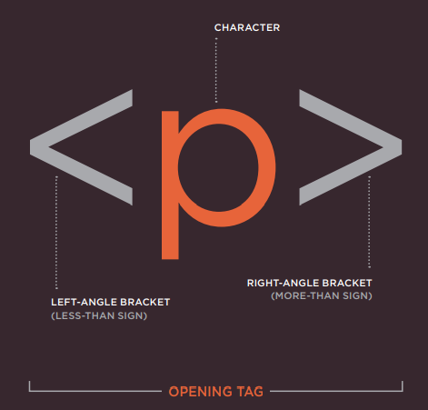
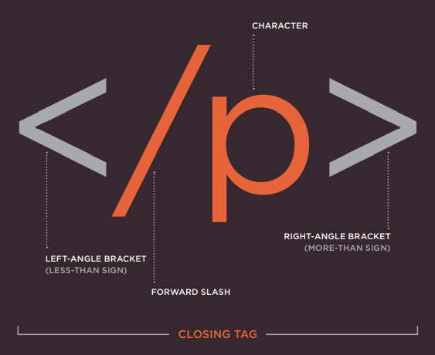
Html elements, Tags
HTML uses elements to describe the structure of pages.
Tags act like containers. They tell you something about the information that lies between their opening and closing tags.

Slide 4
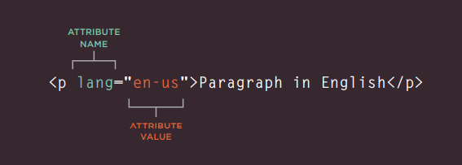
attributes
Attributes tell us more about elements.
It provides additional information about the contents of an element. They appear on the opening tag of the element and are made up of two parts: a name and a value, separated by an equal to sign.

Slide 5
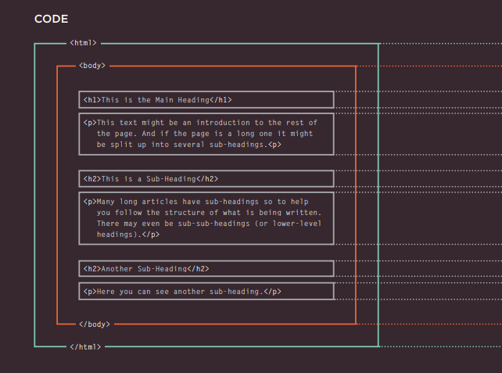
STRUCTURE OF A html document

Slide 6
Body, head & title
<head>:This element is used to pass additional information to the Browser. It contains information about the page.
<title>:Contents of this element are visible one the Title Bar of the page or on the tab for that page.
<body>:This element forms the body of the HTML Document. Everything inside this element will be shown in the main browser window.

Slide 7
Creating web page on your pc
Text Editors:
Notepad.
Sublime Text.
Notepad++.
Visual Studio Code.

Slide 8
Summary
HTML pages are text documents.
HTML uses tags (characters that sit inside angled brackets) to give the information they surround special meaning.
Tags usually come in pairs. The opening tag denotes the start of a piece of content; the closing tag denotes the end.
Opening tags can carry attributes, which tell us more about the content of that element.
Attributes require a name and a value.

Slide 9
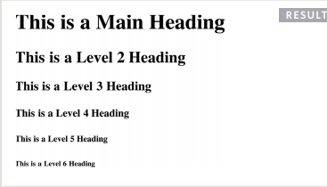
TEXT
HEADING TAGS:HTML has 6 levels of headings starting from <h1> to <h6>.
<h1> element is used for Main Headings.<h2> element is used for Sub Headings and so on.
<h1> is the largest headings and <h6> is the smallest/ least significant heading.
Example - <h1> This is a Main Heading </h1>.

Slide 10
PARAGRAPH ELEMENT:HTML defines a Paragraph using the <p> tag.
To create a paragraph, surround the words that make up the paragraph with an opening <p> tag and closing </p> tag.
By default, a browser will show each paragraph on a new line with some space between it and any subsequent paragraphs.
BOLD & ITALIC:In HTML we can make any word/sentence bold by surrounding the content within the <b></b> tags.
Similarly in order to make characters appear italic we can place them between the <i></i> tags.
SUBSCRIPT & SUPERSCRIPT ELEMENT: The <sub></sub> element is used to display text as a subscript.
Similarly, the <sup></sup> element is used to display text as a Superscript.

Slide 11
HORIZONTAL RULE: The <hr> element can be used to bring about a thematic change to the page. It is an empty tag.
BREAK ELEMENT: A line break inside the middle of a paragraph can be added using <br> tag.

Slide 12
Try yourself
Create a simple HTML Page that demonstrates the various text Markups.
Format the Web page as follows :
Make the heading look distinct from the other text.
Draw a Line across the web page after the Main Heading.
Make the sub headings look distinct from the heading and other text.
Make use of the Subscript and the Superscript Elements anywhere.

Slide 13
Images in html
Images in HTML can be added by using the <img> Element. It is an empty element. The img tag accepts many attributes like,
src – This attribute tells the browser where the image is. The value of this attribute is usually a relative URL of the image.
alt – This attribute provides the alternate text that must be displayed in case when the image is not visible.
title – You can also provide a title to the image.
width – This attribute specifies the width of the image in pixels.
height – this specifies the height of the image in pixels.

Slide 14
FIGURE AND FIGURE CAPTION
<figure> - HTML has introduced an element that contains the images along with their captions so that the two are associated.
<figcaption> - The figcaption element has been added to HTML5 in order to allow web page authors to add a caption to an image.

Slide 15
Lists in html
HTML offers 3 different types of lists.
ORDERED LIST
They are lists where each item in the list is numbered.
Ordered Lists are created using the <ol> </ol> element.
The <li></li> element is used to define the lists. Each item in the list is placed within the <li></li> element.

Slide 16
2. UNORDERED LIST
They are lists that begin with a bullet points.
Unordered Lists are created by using the <ul></ul> element.
Like the Ordered List, unordered Lists also use <li></li> Tag to define the items of the list.
Definition lists - are made up of a set of terms along with the definitions for each of those terms.
3. DEFINITION LIST
They are made up of a set of terms along with the definitions for each of those terms.
The definition Lists are created using the <dl> element and usually consists of series of terms and their description.
The <dt></dt> contains the term to be defined. (Definition Term).
The <dd><dd> contains the definition of the term.

Slide 17
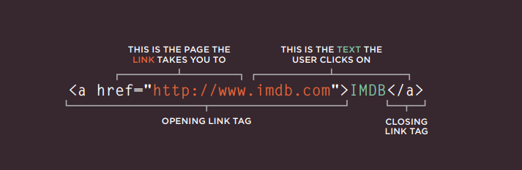
Links In html
In HTML, links are created using the Anchor tag <a> </a>.
The <a> </a> element has an attribute called href whose value is the URL of the page you want the user to go on clicking the link.

Slide 18
We will come across the following types of links:
Links from one website to another.
Links from one page to another on the same website.
Links from one part of a web page to another part of the same page.
Links that open in a new browser window.
Links that start up your email program and address a new email to someone.

Slide 19
Types of Links
ABSOLUTE URL/LINK
An absolute URL starts with the domain name for that site, and can be followed by the path to a specific page. If no page is specified, the site will display the homepage.
Example- https://www.google.co.in.
RELATIVE URL/LINK
These are like a shorthand version of absolute URLs because you do not need to specify the domain name.
Example – Table.html

Slide 20
EMAIL LINKS
To create a link that starts up the user's email program and addresses an email to a specified email address, you use the element. However, this time the value of the href attribute starts with mailto: and is followed by the email address you want the email to be sent to.
Example – <a href=“mailto:sara@gmail.com”> Send mail </a>
when the link is clicked on, the user's email program will open a new email message and address it to the person specified in the link.

Slide 21
TARGET ATTRIBUTE
Anchor Element has another attribute called target that specifies where to open the linked document/page.
Target attribute has multiple values it accepts like –
_self – This specifies that the link be opened in the current page.
_blank – This opens the link in a new page.
Example- <a href=https://www.google.co.in target=“_self”>Click Me </a>

Slide 22
Tables in html
The <table> Element is used to create a table. The contents of the table are written out row by row.
The <tr> element can be used to define each row of the table.
Each cell of the table is defined by the <td></td> tag. The cells of a particular row are placed between the <tr></tr> elements.
The <th></th> element can be used to add the headings to the row or columns of the table. The browser usually displays the content of the <th> tag in bold and in the center of the cell.

Slide 23
Attributes of table
SCOPE
You can use the scope attribute on the <th> element to indicate whether it is a heading for a column or a row.
SPANNING COLUMN
colspan can be used within the <td> or <th> tag to indicate how many columns the cell should run for. It accepts numeric values.
Example - <td colspan=“3”> geography </td>
SPANNING ROW
rowspan can be used within the <td> or <th> tag to indicate how many rows the cell should run for. It accepts numeric values.
Example - <td rowspan=“2”> geography </td>

Slide 24
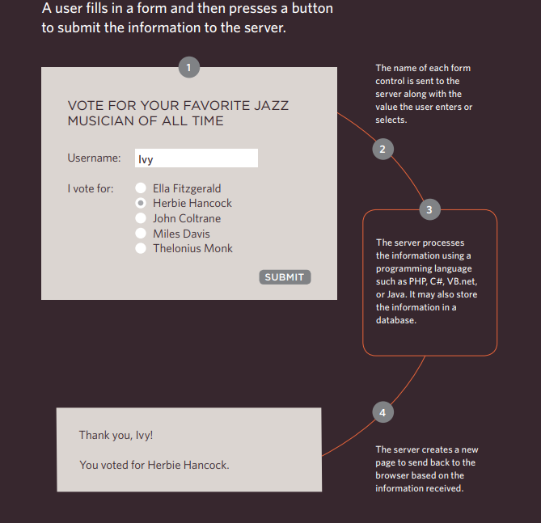
FORMS

Slide 25
Form structure
The Form controls live inside the <form></form> Element.
Each Form element must have the action and method attribute.
Action attribute – It’s value is the URL for the page on the server that will receive the information in the form when it is submitted.
Method attribute – there are 2 methods Get, Post.
With the get method, the values from the form are added to the end of the URL specified in the action attribute.
With the post method the values are sent in what are known as HTTP headers.

Slide 26
Form controls
INPUT – This element is used to create several different form controls. The value of the type attribute determines what kind of input they will be creating.
The different type values are – Text, Password, Email, Radio, Checkbox, file, submit.
Basic format - <input type=“text” name=“ ” value=“ “>………</input>
Name attribute - The value of this attribute identifies the form control and is sent along with the information they enter to the server.

Slide 27
<select></select>
This element is used to create a drop down list box. It contains two or more <option> elements.
<option></option>
This element is used to specify the options that the user can select from. The words between the opening and closing tags will be shown to the user in the drop down box.
<textarea></textarea>
element is used to create a mutli-line text input. Unlike other input elements this is not an empty element. It should therefore have an opening and a closing tag.

Slide 28
Grouping form elements
<fieldset> </fieldset>
You can group related form controls together inside this element.
Most browsers will show the fieldset with a line around the edge to show how they are related.
<legend></legend>
This element can come directly after the opening of the <fieldset> element.
It contains a caption which helps identify the purpose of that group of form controls.

Slide 29
Doctypes & comments
Each web page should begin with a DOCTYPE declaration to tell a browser which version of HTML the page is using (although browsers usually display the page even if it is not included).
The doctype declaration for a HTML 5 document is <!DOCTYPE html>.
COMMENTS
Comments in HTML can be defined using the following tag.
<!-- place the comments here -->
Comment will not be visible in the browser.

Slide 30
Id attribute
Every HTML element can carry the id attribute. It is used to uniquely identify that element from other elements on the page.
Its value should start with a letter or an underscore (not a number or any other character).
It is important that no two elements on the same page have the same value for their id attributes (otherwise the value is no longer unique).
The id attribute is known as a global attribute because it can be used on any element.
Example - <p id=“para_one”>……………</p>

Slide 31
Class attribute
Every HTML element can also carry a class attribute.
Sometimes, rather than uniquely identifying one element within a document, you will want a way to identify several elements as being different from the other elements on the page.
By default, using these attributes does not affect the presentation of an element. It will only change their appearance if there is a CSS rule that indicates it should be displayed differently.
If you would like to indicate that an element belongs to several classes, you can separate class names with a space.

Slide 32
Block & inline elements
BLOCK ELEMENTS –
Some elements will always appear to start on a new line in the browser window. These are known as block level elements.
Example - <h1>, <p>, <ul>, <li>, etc.
INLINE ELEMENTS –
Some elements will always continue to appear on the same line as their neighboring elements. These are known as inline elements.
Example - <a>, <img>, <b>, etc.

Slide 33
Grouping elements in a block
The <div> element allows you to group a set of elements together in one block-level box.
In a browser, the contents of the <div> element will start on a new line, but other than this it will make no difference to the presentation of the page.
It can also make it easier to follow your code if you have used <div> elements to hold each section of the page.
By using the id/class attribute to the <div> element you can style it with the help of CSS properties.
For example - A <div> element can be created to hold all the elements of a nav bar of the web page (like the logo and the navigation).

Slide 34
IFRames
The term iframe is an abbreviation of inline frame. An iframe is like a little window that has been cut into your page — and in that window you can see another page.
Some attributes used in <iframe> element are-
Src - The src attribute specifies the URL of the page to show in the frame.
Height - The height attribute specifies the height of the iframe in pixels.
Width - The width attribute specifies the width of the iframe in pixels.
An iframe can be used as the target frame for a link. The target attribute of the link must refer to the name attribute of the iframe.

Slide 35
Video & audio
VIDEO –
A video can be added to a web page using the <video> element.
An Audio can be added to a HTML document by using the <audio> element.
Both audio and video elements have a no. of attributes that help control the audio/video playback.
Src - This attribute specifies the path to the video/audio.
Controls - When used, this attribute indicates that the browser should supply its own controls for playback.

Slide 36
Autoplay - When used, this attribute specifies that the file should play automatically.
Loop - This attribute specifies that the audio track should play again once it has finished.
Poster - This attribute allows you to specify an image to show while the video is downloading or until the user tells the video to play.
Height, Width - These attributes specify the size of the video player in pixels.

